Slide 1

Comparing Pathfinding Agents: Heuristic vs. Reinforcement Learning
Sohan Mekala

Slide 2
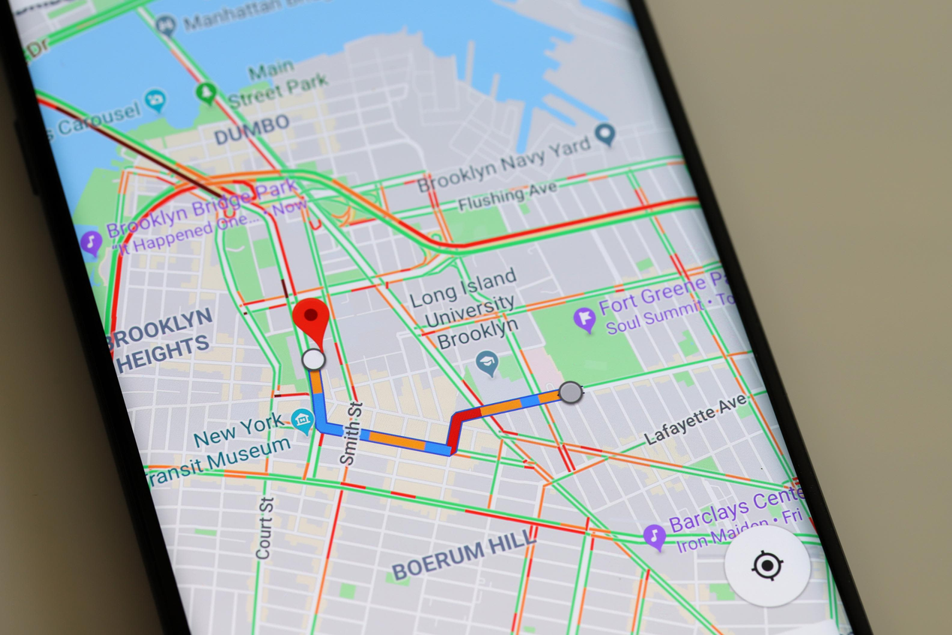
Graph Related Problems
Network Routing
Resource Allocation
GPS Navigation

Slide 3
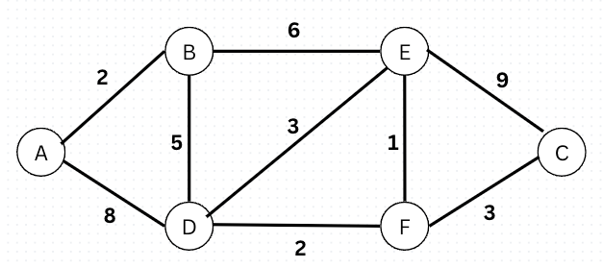
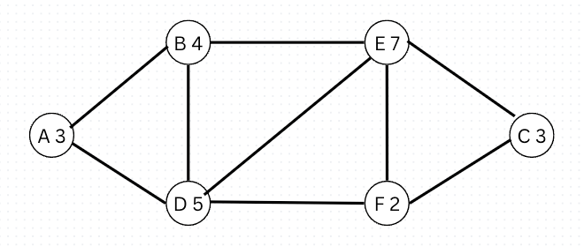
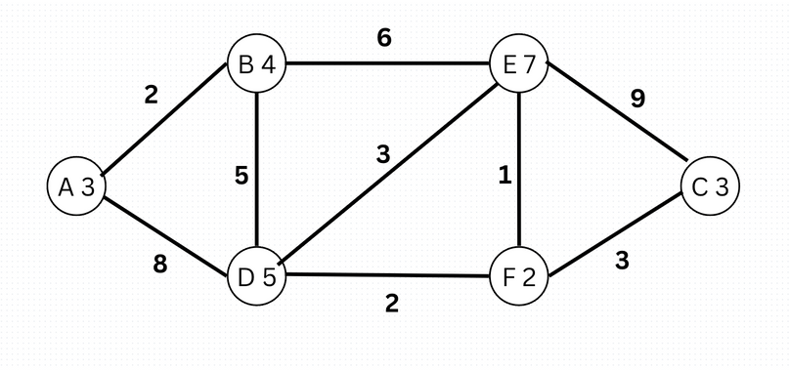
Problem Generalization
Edge values for time related problems
Node values for allocation problems
My research focuses on a combination of both

Slide 4
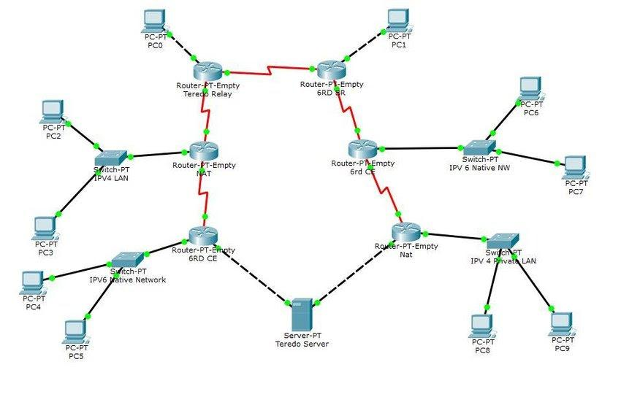
Network Topology Problems
Constant requests/data being passed through
Shortest time/shortest resources
Minimize edge sum, maximize node sum along path

Slide 5
Hueristic
RL
Control Agent
Djikstra’s algorithm
Doesn’t account for node values
Q Learning(Tabular Approach)
Vary Episodes

Slide 6
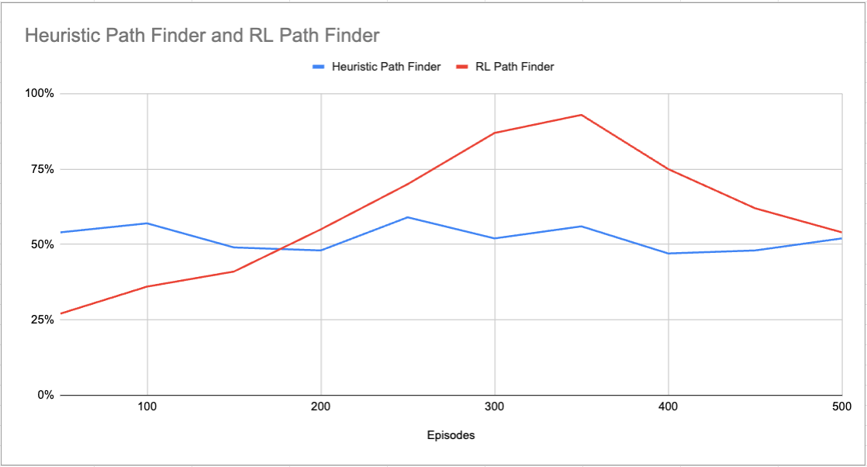
Code: https://github.com/SohanMekala/Pathfinder-Agent-Research/blob/main/agent_comparision.py

Slide 7
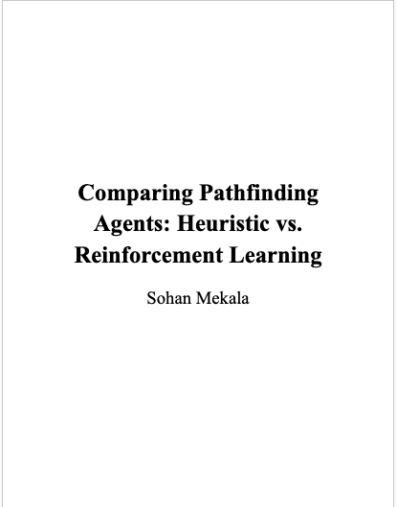
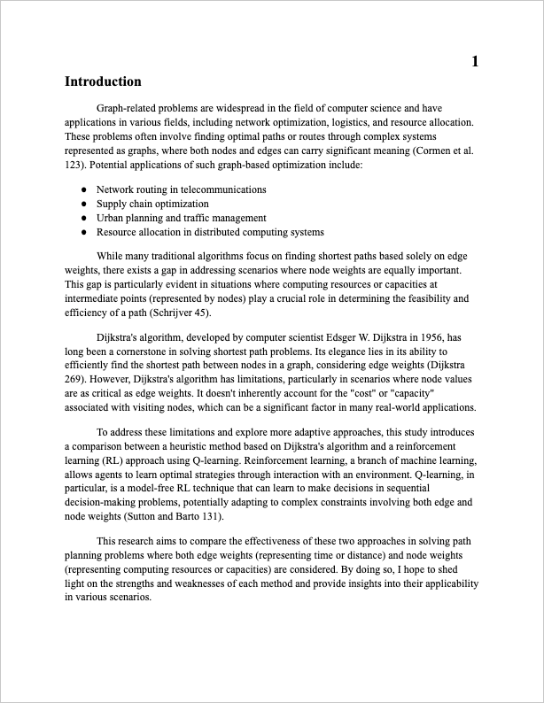
Paper: https://github.com/SohanMekala/Pathfinder-Agent-Research/blob/main/research_paper.pdf

Slide 8
